Slide 1

Watson Studio( cont)

Slide 2
Objectives
Add an interactive Jupyter workbook to work with a real data set.
Link GitHub to Watson Studio and explain when to use public vs. private repositories.
Load and run a sample project in Watson Studio and examine the results.
Use Watson Studio to run an autonumeric model
Watson Studio

Slide 3
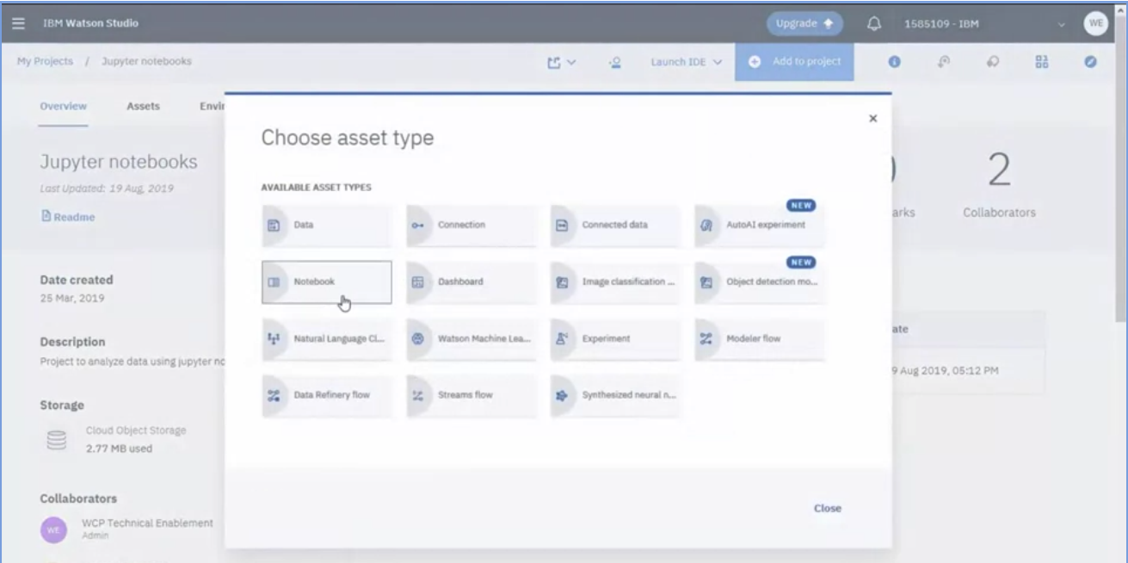
Notebook in Watson
1. click Add to project
2. click Notebook
1
2
Watson Studio

Slide 4
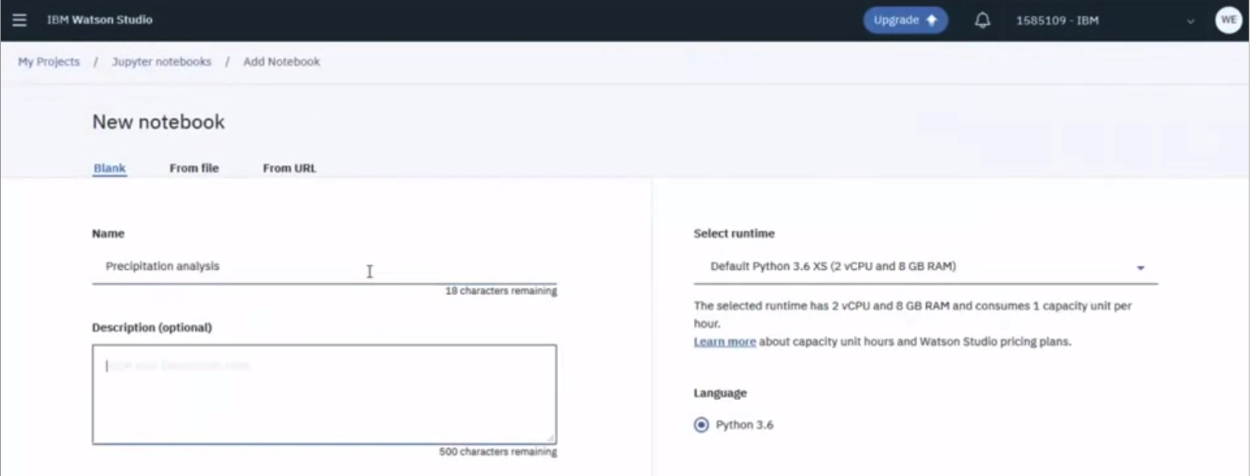
Notebook in Watson
3. input name
4. click create Notebook button
Watson Studio

Slide 5
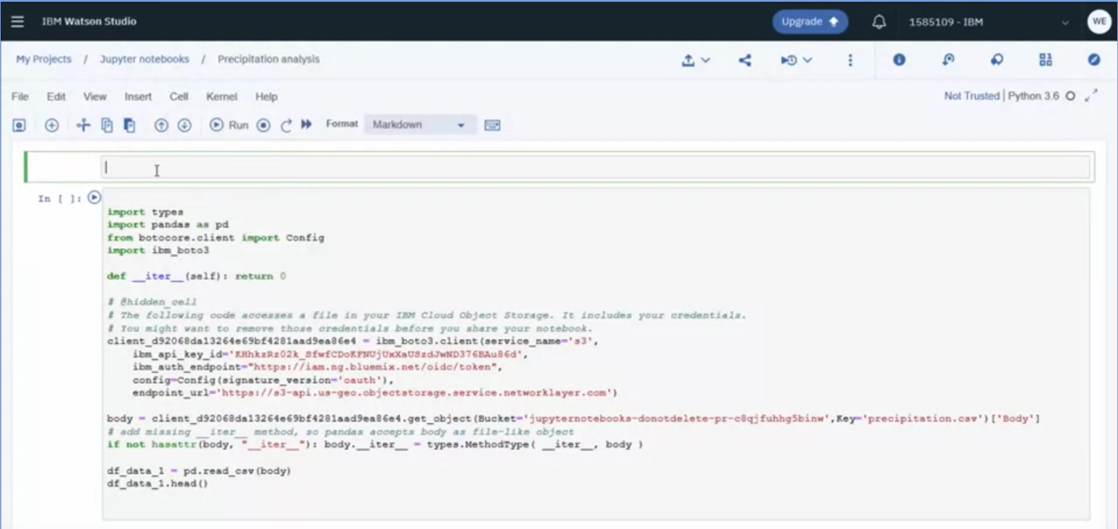
Notebook in Watson
You can add code to Notebook
Watson Studio

Slide 6
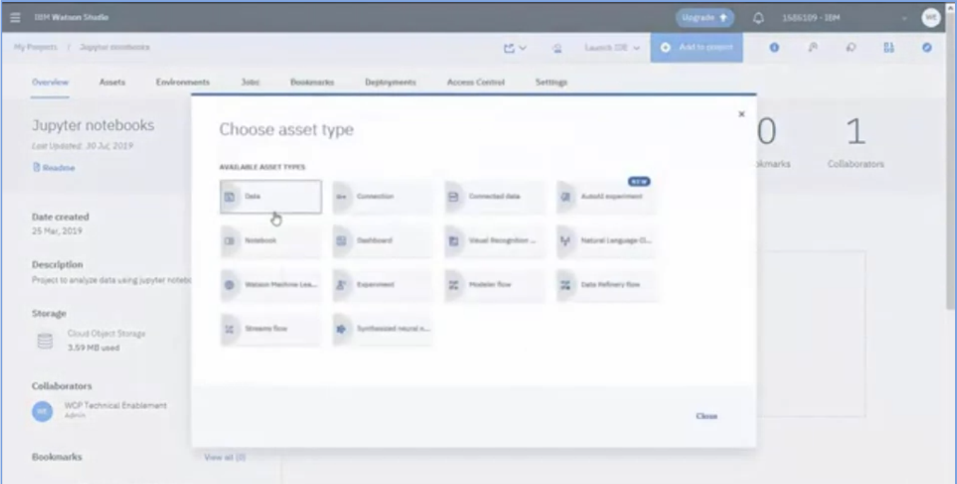
Jupyter Notebook in Watson
1. click Add a project
2. click Data button to adding data set
Watson Studio

Slide 7
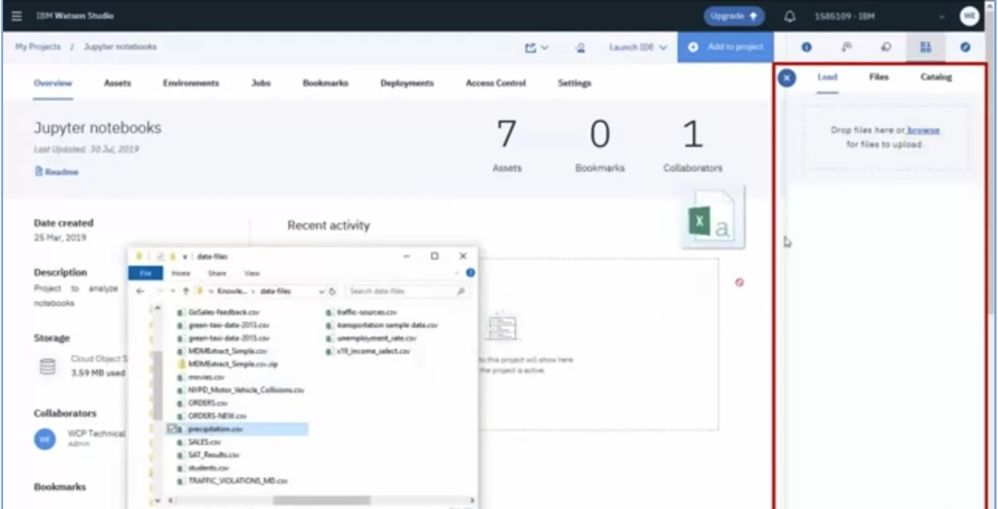
Jupyter Notebook in Watson
you can either browse to select files or drag files into the panel
Watson Studio

Slide 8
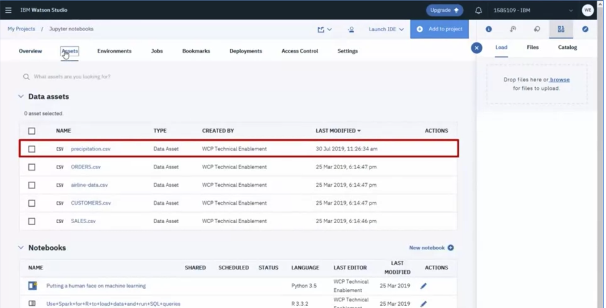
Jupyter Notebook in Watson
data file is uploaded to object storage and available as a data asset in this project
Watson Studio

Slide 9
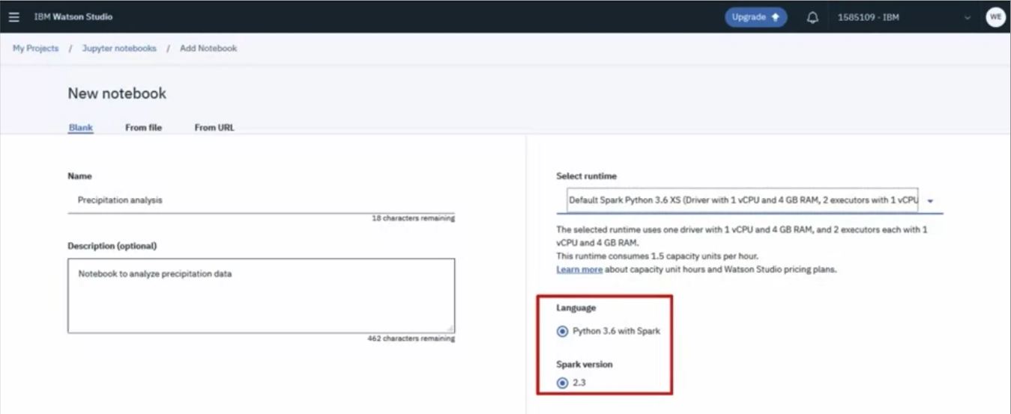
Jupyter Notebook in Watson
Create a new notebook
Watson Studio

Slide 10
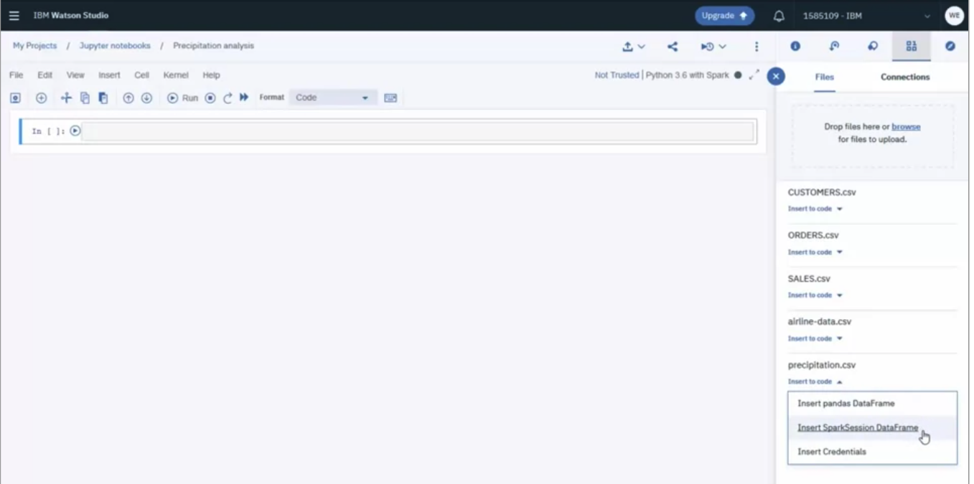
Jupyter Notebook in Watson
You can insert data in imported file
Watson Studio

Slide 11
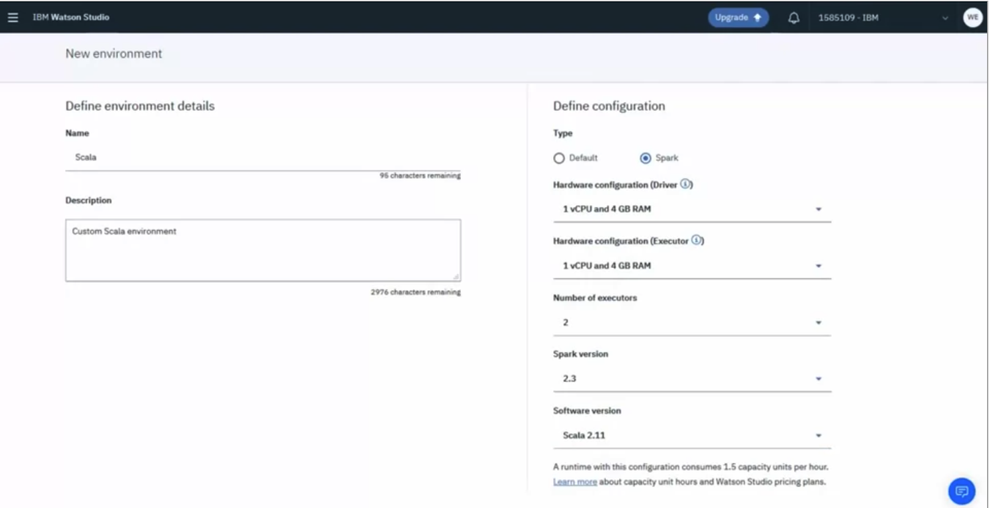
Jupyter Notebook in Watson
You can change or create new environment
Watson Studio

Slide 12
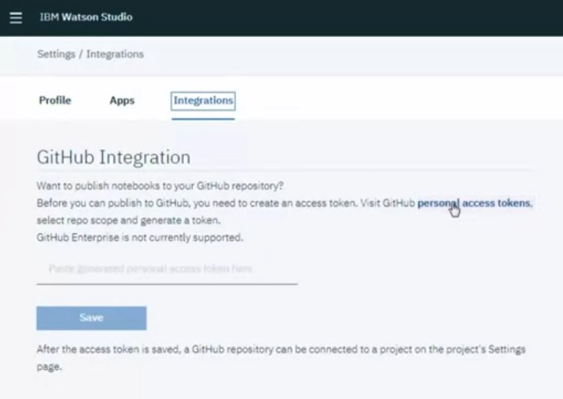
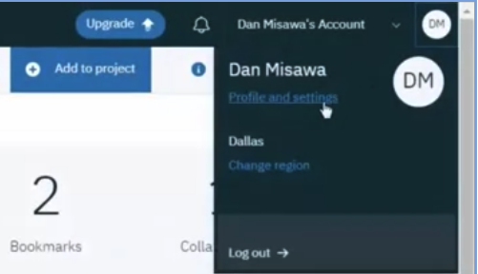
Linking GitHub to Watson
1. In Watson studio navigate to your profile settings on the integrations tab
2. On the integrations tab visit the link to generate a github personal access token
Watson Studio

Slide 13
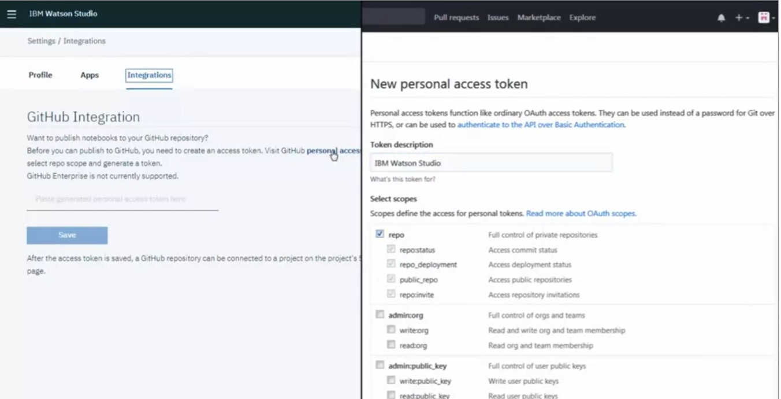
Linking GitHub to Watson
3. provide a descriptive name for the token and select the repo scope then generate the token
Watson Studio

Slide 14
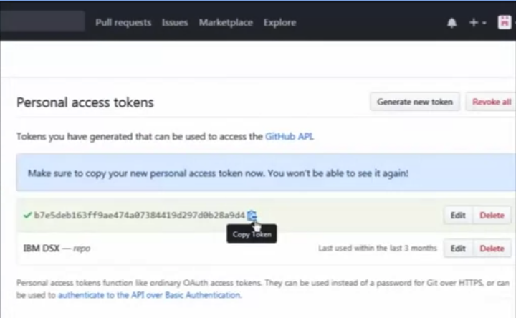
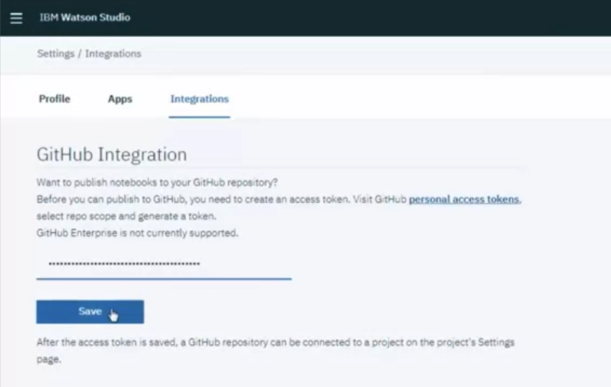
Linking GitHub to Watson
4. copy tokens and return to the github integration settings and paste the token the token
Watson Studio

Slide 15
Linking GitHub to Watson
5. when you save it to your profile settings now navigate to your projects you enable github integration at the project level
6. On the settings tab simply scroll to the bottom and paste he existing github repository URL once the URL is validated
7. click connect
Watson Studio

Slide 16
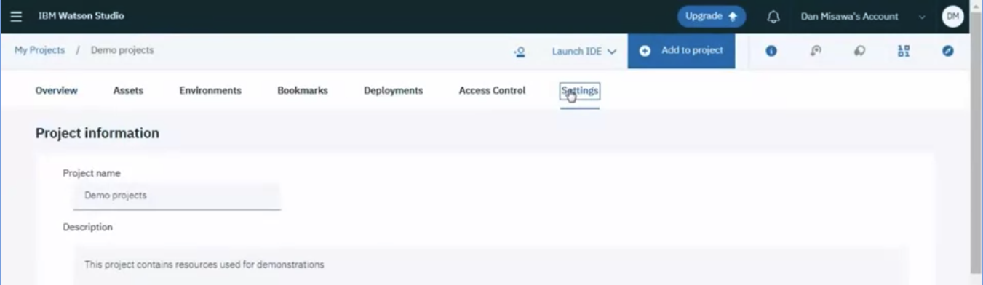
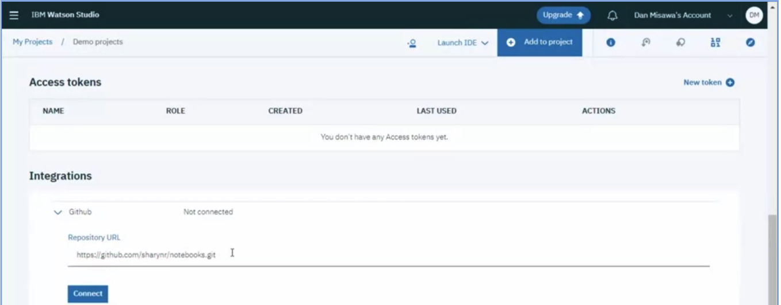
Linking GitHub to Watson
Watson Studio

Slide 17
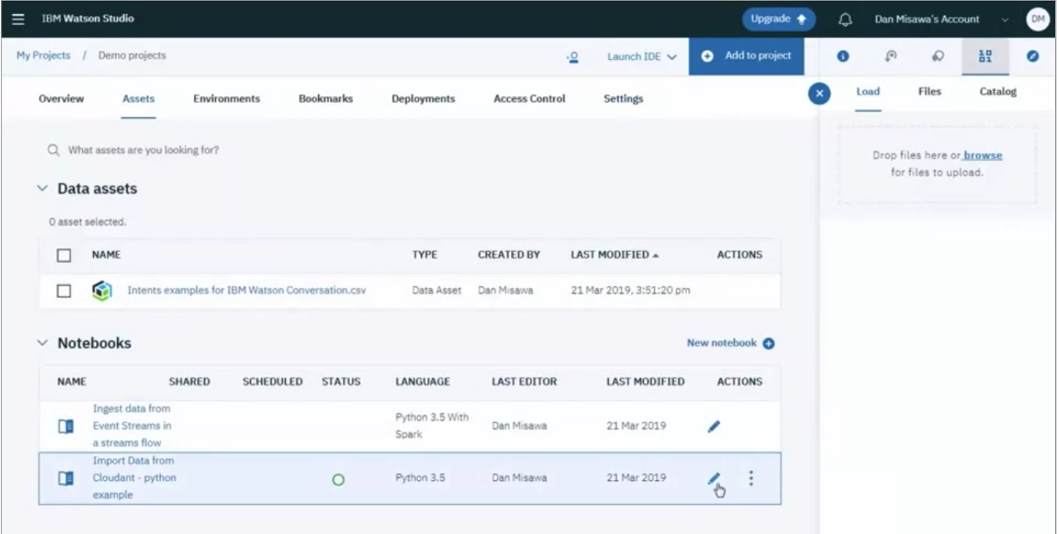
Linking GitHub to Watson
8. go to the assets tab and open the notebook you want to publish
Watson Studio

Slide 18
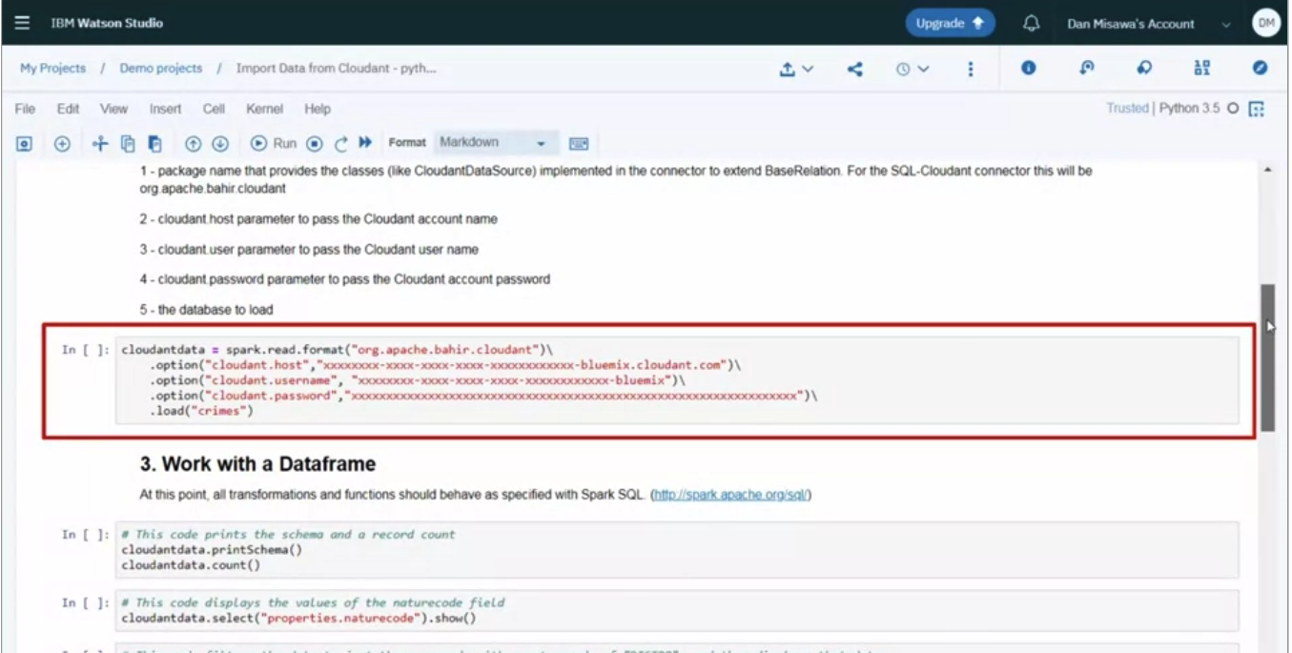
Linking GitHub to Watson
9. linked GitHub to watson
Watson Studio

Slide 19
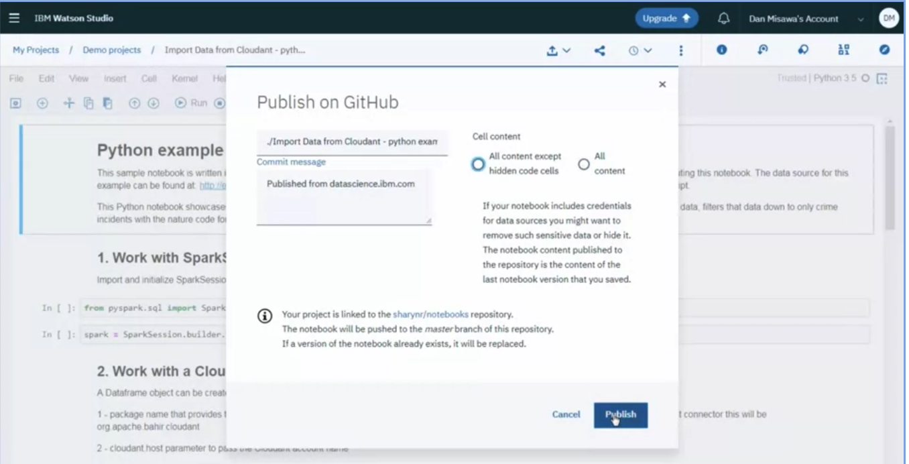
Linking GitHub to Watson
10. this notebook is ready for publishing
Watson Studio

Slide 20
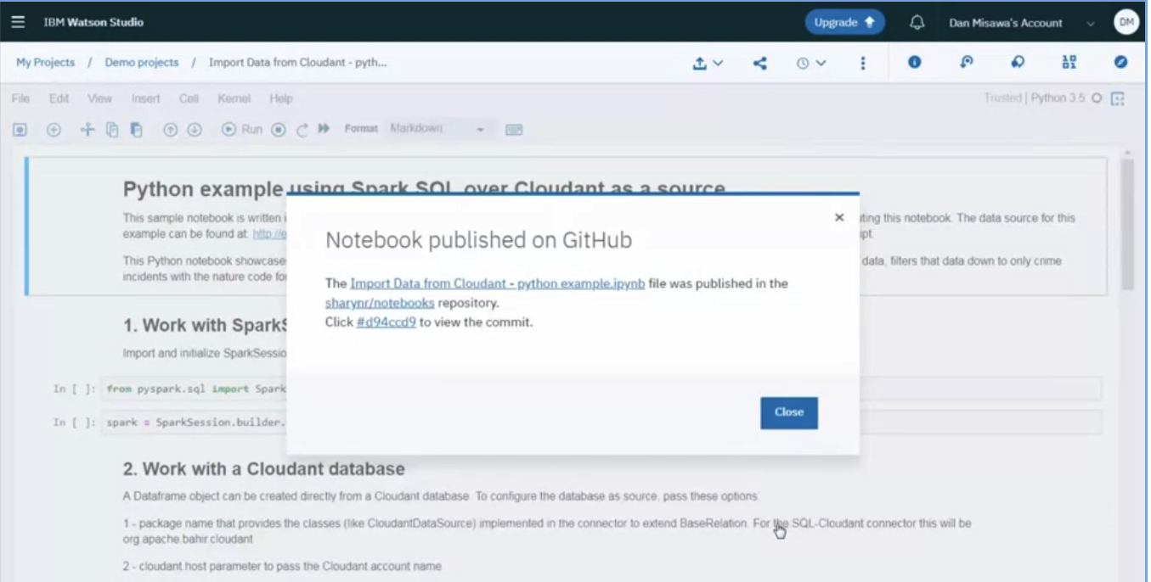
Linking GitHub to Watson
11. Notebook published on GitHub
Watson Studio

Slide 21
Summary
Add an interactive Jupyter workbook to work with a real data set.
Link GitHub to Watson Studio and explain when to use public vs. private repositories.
Load and run a sample project in Watson Studio and examine the results.
Use Watson Studio to run an autonumeric model
Watson Studio

Slide 22
Q & A
Watson Studio

